Slide 1
DUDETM: Building Durable Transactions with Decoupling for Persistent Memory
118037930082 Zhao Hongda,
2019.3.29

Slide 2
Outline
DUDETM Design
Background
The Decoupled Framework
Three decoupled, asynchronous steps
Implementation
Memory Management
Evaluation
Conclusion

Slide 3
Background
Requirements of Durable Transactions
Transactions are applicable to persistent memory
ACID
Drawbacks of Undo and Redo Logging
Enforce persist ordering for every memory write in a transaction
intercepting and redirecting writes and reads

Slide 4
The Decoupled Framework
Shadow Memory Feature
Shared
Cross-transaction
cost-effective page-level management
Reserved memory page
use an out-of-the-box TM to execute transactions
Redo only log
Shadow Memory
map
Persistent Memory

Slide 5
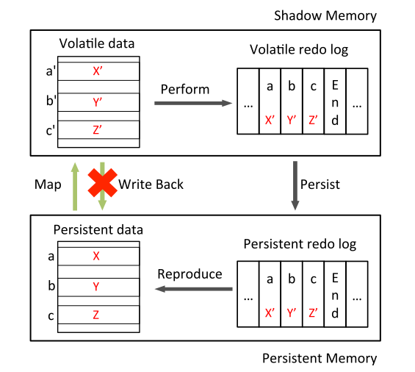
Three decoupled, asynchronous steps

Slide 6
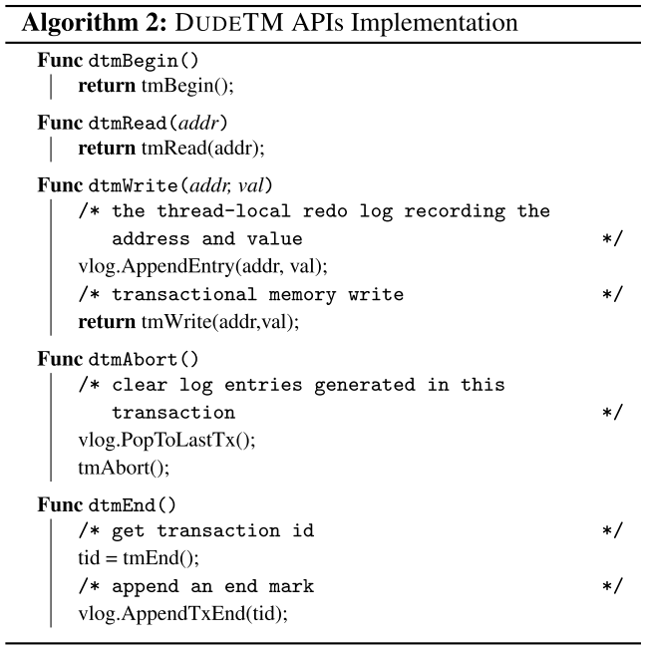
Perform API

Slide 7
Perform
Dtmbegin
transaction ID
Store in buffer
Create entry
Dtmend
Global Unique

Slide 8
Persist

Slide 9
Persist
One or more background thread
Latest durable transaction ID
All transactions with smaller durable IDs are persistent
The redo logs do not have to be flushed according to the commit order of transactions
transaction1
batch
Persistent log region
transaction2

Slide 10
Log Combination
entry1
write
内存A
write
entry2

Slide 11
Log Combination
transaction1
transaction3
transaction4
transaction5
…
transaction1
transaction2
group1
group2
group3
Hash
Hash
Hash table
entry2
flush
Persistent memory

Slide 12
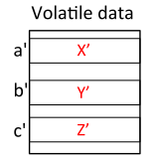
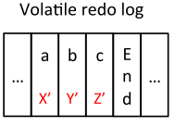
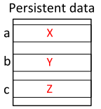
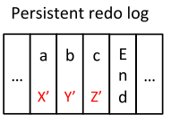
Log Compression
lz4 algorithm
compression ratio over 69%
Decompression is not always needed
reproduce

Slide 13
Reproduce

Slide 14
Recovery
the recovery procedure replays the redo logs in an increasing order of their transaction IDs
restore persistent memory allocation information
API
pmalloc
pfree

Slide 15
Memory Management
No shadow memory space is available
swap
Shadow memory
Touching ID
Persistent memory
9
6
4
5
8
7

Slide 16
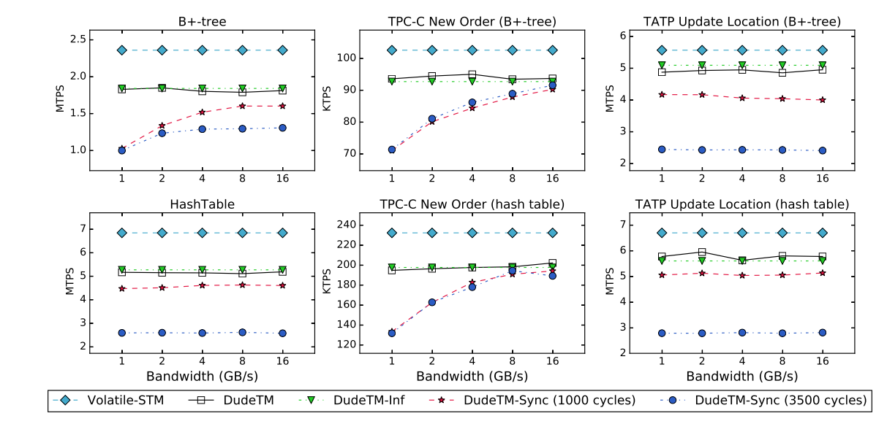
Evaluation

Slide 17
DUDETM incurs minor overhead (7.4% ∼24.6% less throughput) over the original volatile STM
memory writes
Log flushing is not the bottleneck of the decoupled framework in DUDETM.
the Perform step of a transaction is rarely blocked by a full log buffer
Decoupling enables high performance of DUDETM and avoids the bottleneck in log flushing.

Slide 18
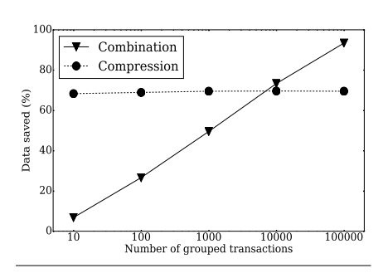
Log Optimization

Slide 19
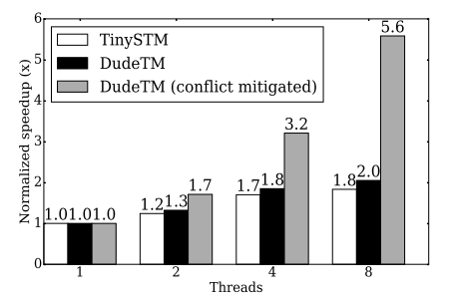
Scalability

Slide 20
Conclusion
DUDETM, a decoupled framework
three asynchronous steps
Reduce the write traffic to NVM by log optimization
improve throughput

Slide 21
Thank you！

Slide 22


